Slide 1
Lecture 11:
CNNs in Practice

Slide 2
Administrative
Midterms are graded!
Pick up now
Or in Andrej, Justin, Albert, or Serena’s OH
Project milestone due today, 2/17 by midnight
Turn in to Assignments tab on Coursework!
Assignment 2 grades soon
Assignment 3 released, due 2/24

Slide 3
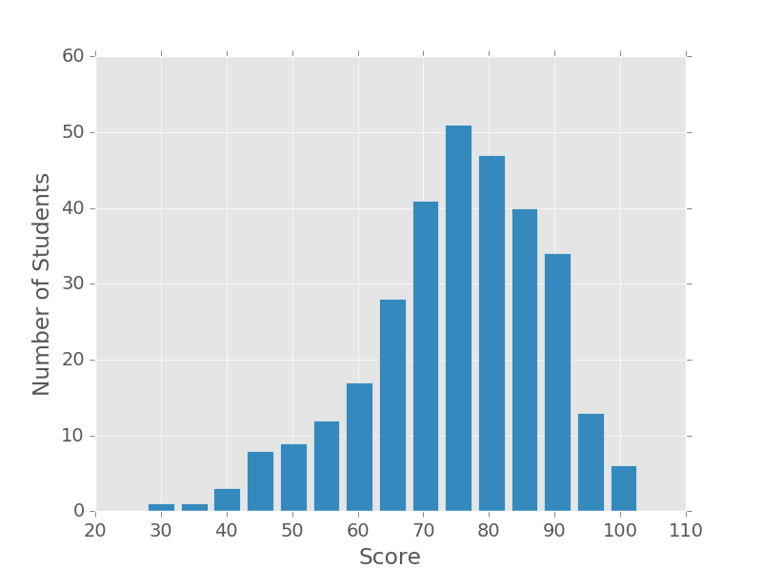
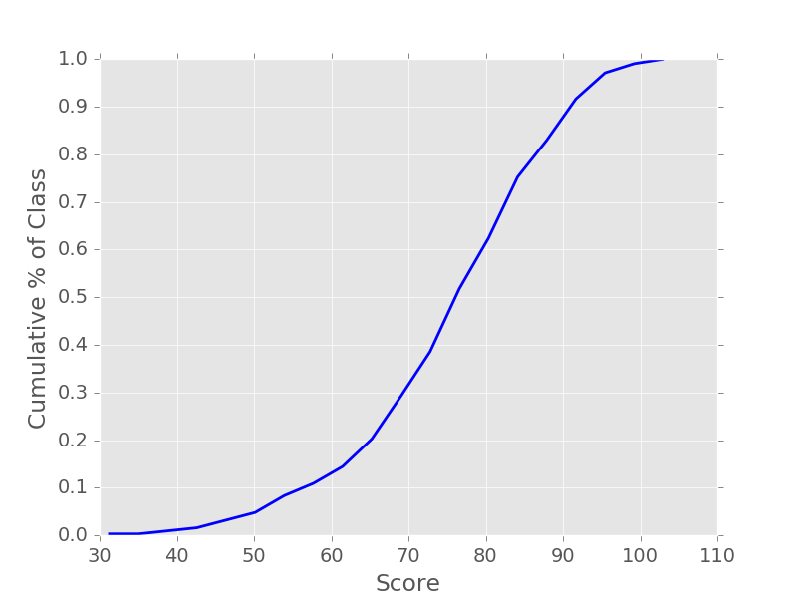
Midterm stats
Mean: 75.0 Median: 76.3 Standard Deviation: 13.2
N: 311 Max: 103.0

Slide 4
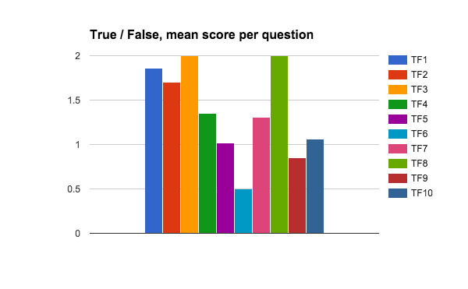
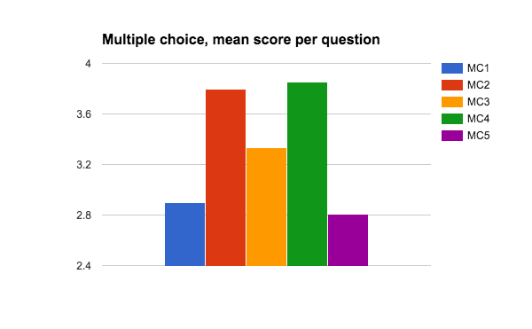
Midterm stats
[We threw out TF3 and TF8]

Slide 5
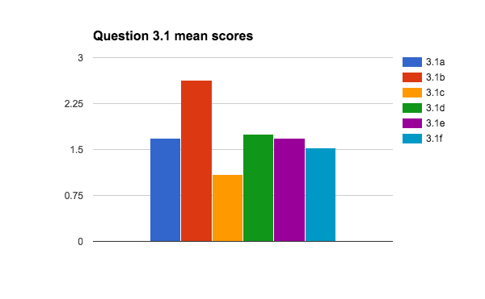
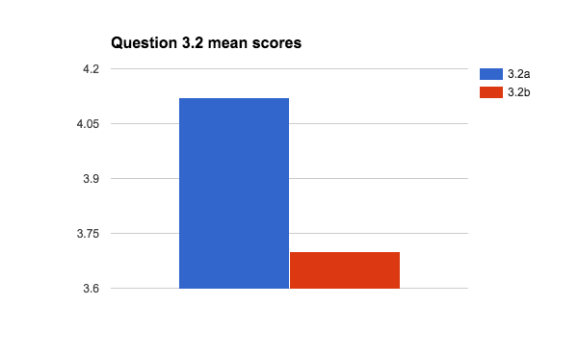
Midterm stats

Slide 6
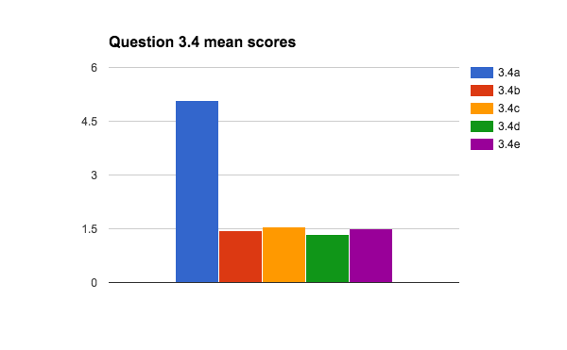
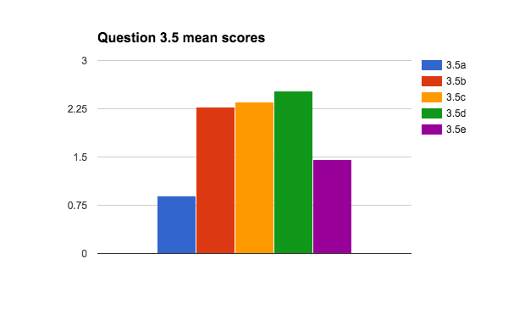
Midterm Stats
Bonus mean: 0.8

Slide 7
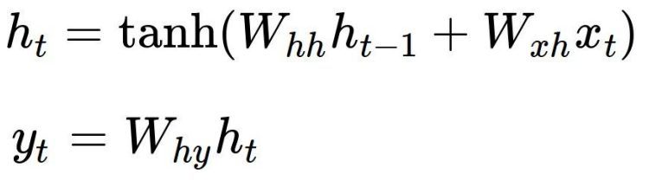

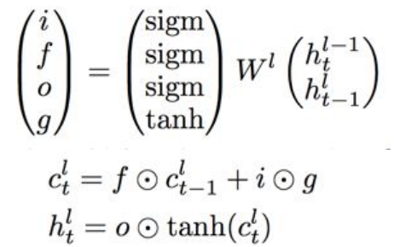
Last Time
Vanilla RNNs
LSTMs
Recurrent neural networks for modeling sequences

Slide 8
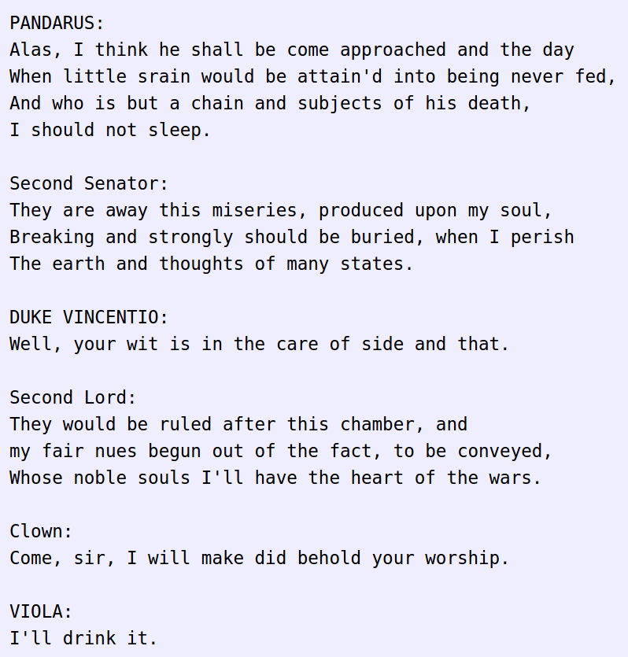
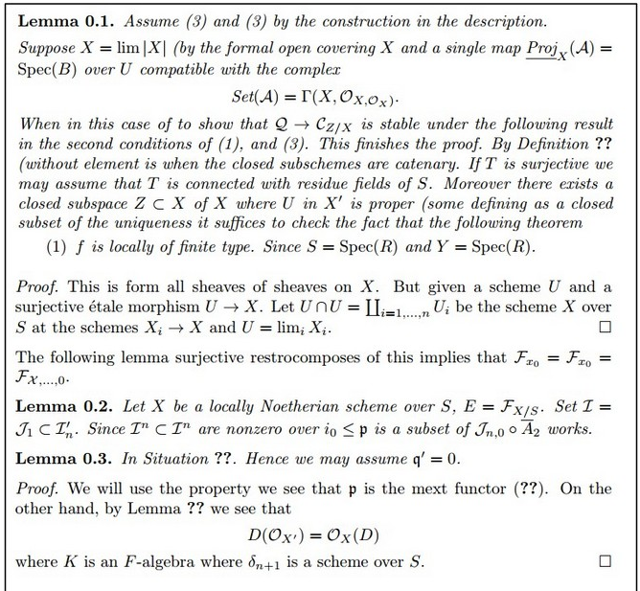
Last Time
Sampling from RNN language models to generate text

Slide 9
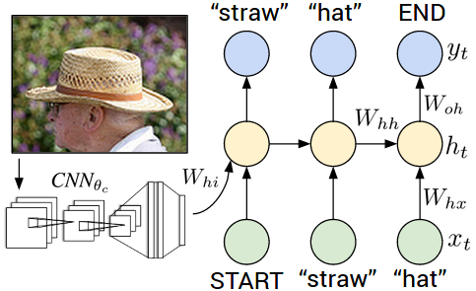
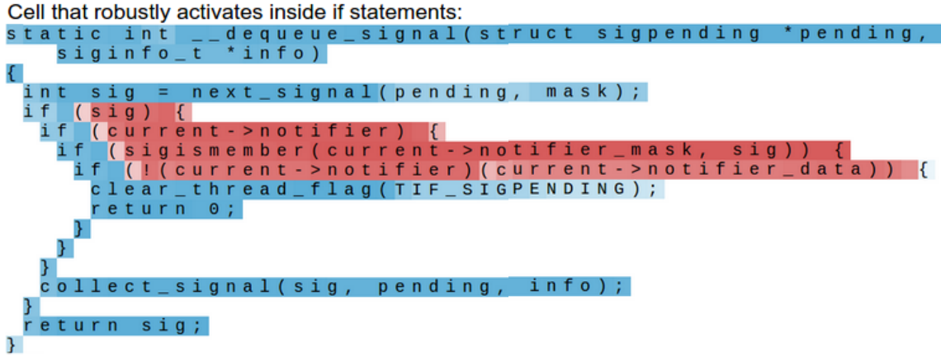
Last Time
CNN + RNN for image captioning
Interpretable RNN cells

Slide 10
Today
Working with CNNs in practice:
Making the most of your data
Data augmentation
Transfer learning
All about convolutions:
How to arrange them
How to compute them fast
“Implementation details”
GPU / CPU, bottlenecks, distributed training

Slide 11
Data Augmentation

Slide 12
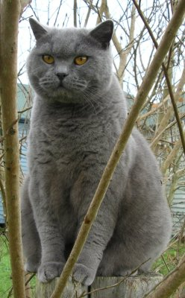
Data Augmentation
“cat”
Load image and label
Compute
loss
CNN

Slide 13
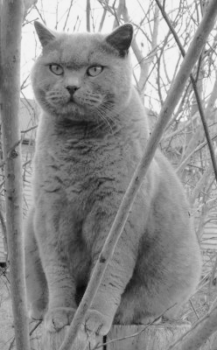
Data Augmentation
“cat”
Load image and label
Compute
loss
CNN
Transform image

Slide 14
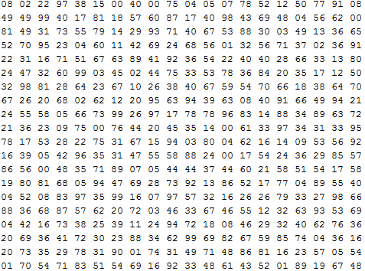
Data Augmentation
Change the pixels without changing the label
Train on transformed data
VERY widely used
What the computer sees

Slide 15
Data Augmentation
Horizontal flips

Slide 16
Data Augmentation
2. Random crops/scales
Training: sample random crops / scales

Slide 17
Data Augmentation
2. Random crops/scales
Training: sample random crops / scales ResNet:
Pick random L in range [256, 480]
Resize training image, short side = L
Sample random 224 x 224 patch

Slide 18
Data Augmentation
2. Random crops/scales
Training: sample random crops / scales ResNet:
Pick random L in range [256, 480]
Resize training image, short side = L
Sample random 224 x 224 patch
Testing: average a fixed set of crops

Slide 19
Data Augmentation
2. Random crops/scales
Training: sample random crops / scales ResNet:
Pick random L in range [256, 480]
Resize training image, short side = L
Sample random 224 x 224 patch
Testing: average a fixed set of crops
ResNet:
Resize image at 5 scales: {224, 256, 384, 480, 640}
For each size, use 10 224 x 224 crops: 4 corners + center, + flips

Slide 20
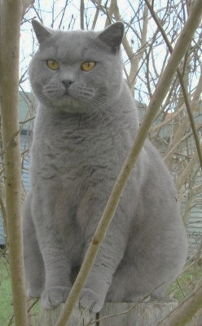
Data Augmentation
3. Color jitter
Simple:
Randomly jitter contrast

Slide 21
Data Augmentation
3. Color jitter
Complex:
Apply PCA to all [R, G, B] pixels in training set
Sample a “color offset” along principal component directions
Add offset to all pixels of a training image
Simple:
Randomly jitter contrast
(As seen in [Krizhevsky et al. 2012], ResNet, etc)

Slide 22
Data Augmentation
4. Get creative!
Random mix/combinations of :
translation
rotation
stretching
shearing,
lens distortions, … (go crazy)

Slide 23
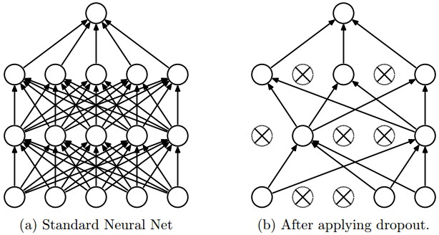
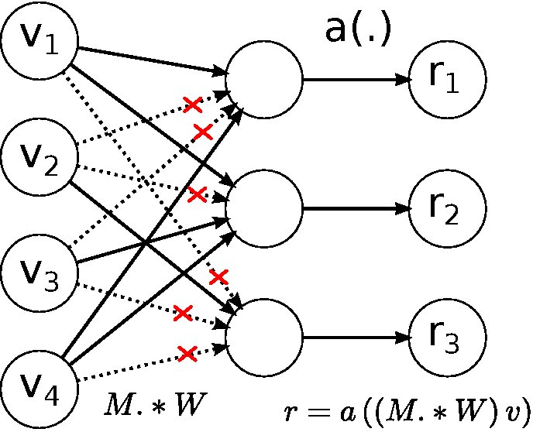
A general theme:
Training: Add random noise
Testing: Marginalize over the noise
Dropout
DropConnect
Data Augmentation
Batch normalization, Model ensembles

Slide 24
Data Augmentation: Takeaway
Simple to implement, use it
Especially useful for small datasets
Fits into framework of noise / marginalization

Slide 25
Transfer Learning
“You need a lot of a data if you want to train/use CNNs”
Notes:
~ 10 - 15 minutes

Slide 26
Transfer Learning
“You need a lot of a data if you want to train/use CNNs”
BUSTED

Slide 27
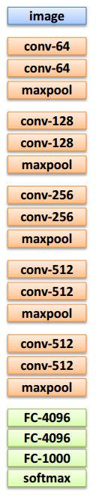
Transfer Learning with CNNs
1. Train on
Imagenet

Slide 28
Transfer Learning with CNNs
2. Small dataset:
feature extractor
1. Train on
Imagenet
Freeze these
Train this

Slide 29
Transfer Learning with CNNs
2. Small dataset:
feature extractor
3. Medium dataset:
finetuning
more data = retrain more of the network (or all of it)
1. Train on
Imagenet
Freeze these
Freeze these
Train this
Train this

Slide 30
Transfer Learning with CNNs
2. Small dataset:
feature extractor
3. Medium dataset:
finetuning
more data = retrain more of the network (or all of it)
1. Train on
Imagenet
Freeze these
Freeze these
tip: use only ~1/10th of the original learning rate in finetuning top layer, and ~1/100th on intermediate layers
Train this
Train this

Slide 31
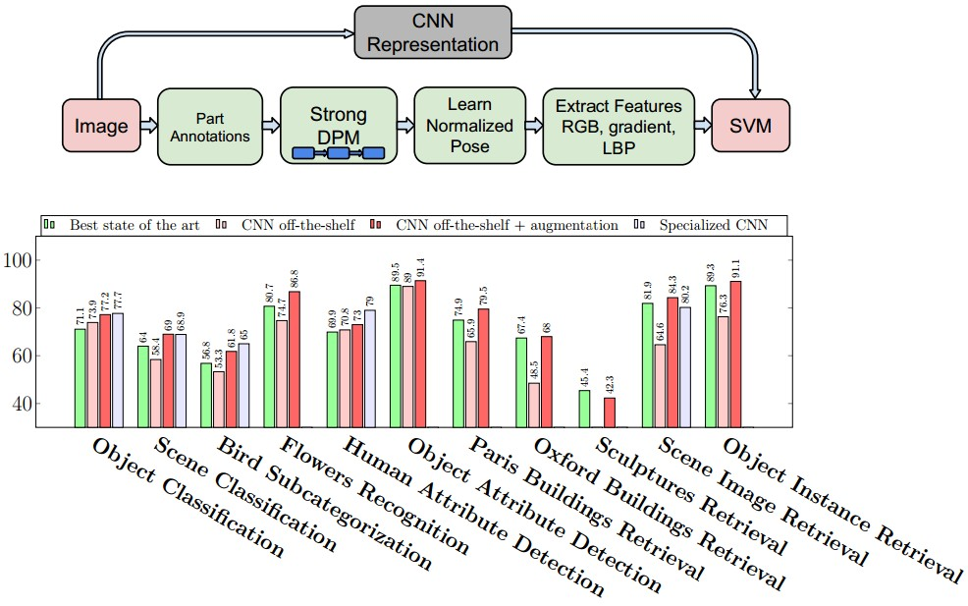
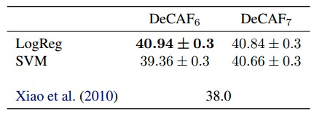
CNN Features off-the-shelf: an Astounding Baseline for Recognition
[Razavian et al, 2014]
DeCAF: A Deep Convolutional Activation Feature for Generic Visual Recognition
[Donahue*, Jia*, et al., 2013]
Notes:
Need to reread the papers

Slide 32
 | very similar dataset | very different dataset
very little data | ? | ?
quite a lot of data | ? | ?
more generic
more specific

Slide 33
 | very similar dataset | very different dataset
very little data | Use Linear Classifier on top layer | ?
quite a lot of data | Finetune a few layers | ?
more generic
more specific

Slide 34
 | very similar dataset | very different dataset
very little data | Use Linear Classifier on top layer | You’re in trouble… Try linear classifier from different stages
quite a lot of data | Finetune a few layers | Finetune a larger number of layers
more generic
more specific

Slide 35
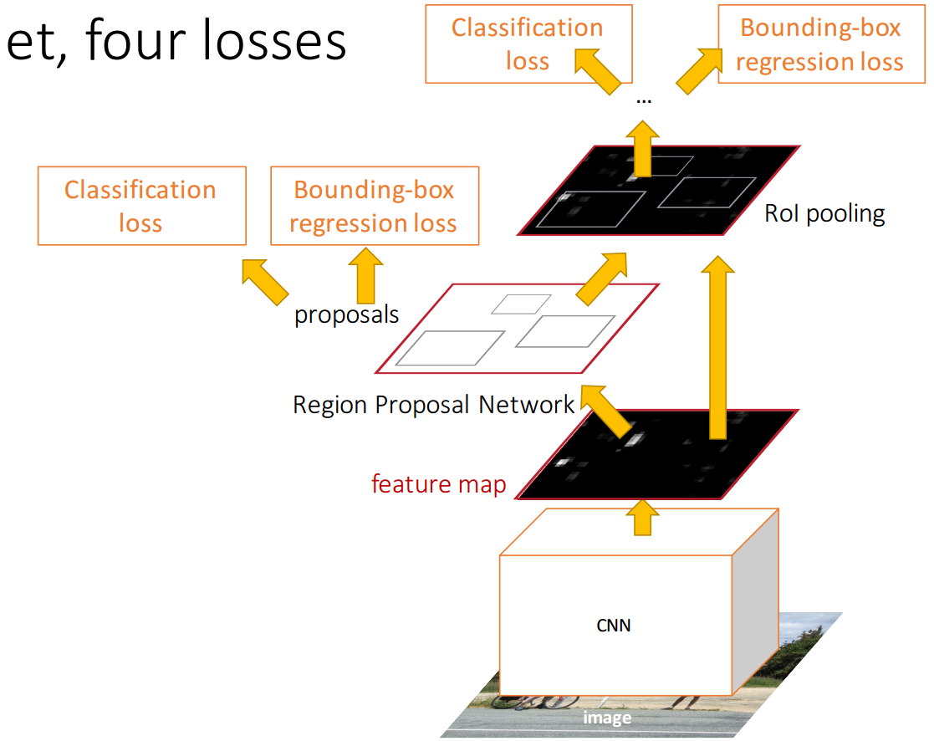
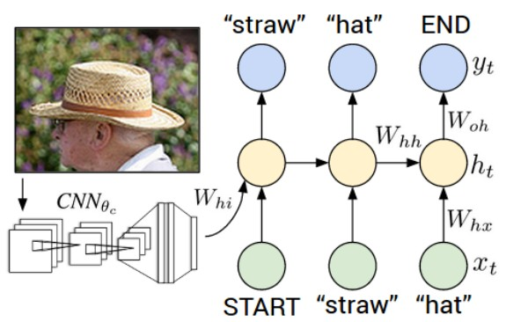
Transfer learning with CNNs is pervasive…
(it’s the norm, not an exception)
Image Captioning: CNN + RNN
Object Detection (Faster R-CNN)

Slide 36
Transfer learning with CNNs is pervasive…
(it’s the norm, not an exception)
Image Captioning: CNN + RNN
CNN pretrained on ImageNet
Object Detection (Faster R-CNN)

Slide 37
Transfer learning with CNNs is pervasive…
(it’s the norm, not an exception)
Image Captioning: CNN + RNN
CNN pretrained on ImageNet
Object Detection (Faster R-CNN)
Word vectors pretrained from word2vec

Slide 38
Takeaway for your projects/beyond:
Have some dataset of interest but it has < ~1M images?
Find a very large dataset that has similar data, train a big ConvNet there.
Transfer learn to your dataset
Caffe ConvNet library has a “Model Zoo” of pretrained models:
https://github.com/BVLC/caffe/wiki/Model-Zoo

Slide 39
All About Convolutions
Notes:
Should be ~25 minutes in by this point

Slide 40
All About Convolutions Part I: How to stack them

Slide 41
The power of small filters
Suppose we stack two 3x3 conv layers (stride 1)
Each neuron sees 3x3 region of previous activation map
Input
First Conv
Second Conv

Slide 42
The power of small filters
Question: How big of a region in the input does a neuron on the second conv layer see?
Input
First Conv
Second Conv

Slide 43
The power of small filters
Question: How big of a region in the input does a neuron on the second conv layer see?
Answer: 5 x 5
Input
First Conv
Second Conv

Slide 44
The power of small filters
Question: If we stack three 3x3 conv layers, how big of an input region does a neuron in the third layer see?

Slide 45
The power of small filters
Question: If we stack three 3x3 conv layers, how big of an input region does a neuron in the third layer see?
 |  |  |  |  | X
 |  |  |  | X
Answer: 7 x 7

Slide 46
The power of small filters
Question: If we stack three 3x3 conv layers, how big of an input region does a neuron in the third layer see?
 |  |  |  |  | X
 |  |  |  | X
Three 3 x 3 conv gives similar
representational
power as a single 7 x 7 convolution
Answer: 7 x 7

Slide 47
The power of small filters
Suppose input is H x W x C and we use convolutions with C filters to preserve depth (stride 1, padding to preserve H, W)

Slide 48
The power of small filters
Suppose input is H x W x C and we use convolutions with C filters to preserve depth (stride 1, padding to preserve H, W)
one CONV with 7 x 7 filters
Number of weights:
three CONV with 3 x 3 filters
Number of weights:

Slide 49
The power of small filters
Suppose input is H x W x C and we use convolutions with C filters to preserve depth (stride 1, padding to preserve H, W)
one CONV with 7 x 7 filters
Number of weights:
= C x (7 x 7 x C) = 49 C²
three CONV with 3 x 3 filters
Number of weights:
= 3 x C x (3 x 3 x C) = 27 C²

Slide 50
The power of small filters
Suppose input is H x W x C and we use convolutions with C filters to preserve depth (stride 1, padding to preserve H, W)
one CONV with 7 x 7 filters
Number of weights:
= C x (7 x 7 x C) = 49 C²
three CONV with 3 x 3 filters
Number of weights:
= 3 x C x (3 x 3 x C) = 27 C²
Fewer parameters, more nonlinearity = GOOD

Slide 51
The power of small filters
Suppose input is H x W x C and we use convolutions with C filters to preserve depth (stride 1, padding to preserve H, W)
one CONV with 7 x 7 filters
Number of weights:
= C x (7 x 7 x C) = 49 C²
Number of multiply-adds:
three CONV with 3 x 3 filters
Number of weights:
= 3 x C x (3 x 3 x C) = 27 C²
Number of multiply-adds:

Slide 52
The power of small filters
Suppose input is H x W x C and we use convolutions with C filters to preserve depth (stride 1, padding to preserve H, W)
one CONV with 7 x 7 filters
Number of weights:
= C x (7 x 7 x C) = 49 C²
Number of multiply-adds:
= (H x W x C) x (7 x 7 x C)
= 49 HWC²
three CONV with 3 x 3 filters
Number of weights:
= 3 x C x (3 x 3 x C) = 27 C²
Number of multiply-adds:
= 3 x (H x W x C) x (3 x 3 x C)
= 27 HWC²

Slide 53
The power of small filters
Suppose input is H x W x C and we use convolutions with C filters to preserve depth (stride 1, padding to preserve H, W)
one CONV with 7 x 7 filters
Number of weights:
= C x (7 x 7 x C) = 49 C²
Number of multiply-adds:
= 49 HWC²
three CONV with 3 x 3 filters
Number of weights:
= 3 x C x (3 x 3 x C) = 27 C²
Number of multiply-adds:
= 27 HWC²
Less compute, more nonlinearity = GOOD

Slide 54
The power of small filters
Why stop at 3 x 3 filters? Why not try 1 x 1?

Slide 55
The power of small filters
Why stop at 3 x 3 filters? Why not try 1 x 1?
“bottleneck” 1 x 1 conv to reduce dimension
H x W x C
Conv 1x1, C/2 filters
H x W x (C / 2)

Slide 56
The power of small filters
Why stop at 3 x 3 filters? Why not try 1 x 1?
“bottleneck” 1 x 1 conv to reduce dimension
3 x 3 conv at reduced dimension
H x W x C
Conv 1x1, C/2 filters
H x W x (C / 2)
Conv 3x3, C/2 filters
H x W x (C / 2)

Slide 57
The power of small filters
Why stop at 3 x 3 filters? Why not try 1 x 1?
“bottleneck” 1 x 1 conv to reduce dimension
3 x 3 conv at reduced dimension
Restore dimension with another 1 x 1 conv
[Seen in Lin et al, “Network in Network”, GoogLeNet, ResNet]
H x W x C
Conv 1x1, C/2 filters
H x W x (C / 2)
Conv 3x3, C/2 filters
H x W x (C / 2)
Conv 1x1, C filters
H x W x C

Slide 58
The power of small filters
Why stop at 3 x 3 filters? Why not try 1 x 1?
H x W x C
Conv 1x1, C/2 filters
Bottleneck sandwich
H x W x C
H x W x (C / 2)
Conv 3x3, C/2 filters
Conv 3x3, C filters
H x W x (C / 2)
Single 3 x 3 conv
H x W x C
Conv 1x1, C filters
H x W x C

Slide 59
The power of small filters
Why stop at 3 x 3 filters? Why not try 1 x 1?
More nonlinearity, fewer params, less compute!
H x W x C
Conv 1x1, C/2 filters
3.25 C² parameters
H x W x C
H x W x (C / 2)
Conv 3x3, C/2 filters
Conv 3x3, C filters
H x W x (C / 2)
9 C² parameters
H x W x C
Conv 1x1, C filters
H x W x C

Slide 60
The power of small filters
Still using 3 x 3 filters … can we break it up?

Slide 61
The power of small filters
Still using 3 x 3 filters … can we break it up?
H x W x C
Conv 1x3, C filters
H x W x C
Conv 3x1, C filters
H x W x C

Slide 62
The power of small filters
Still using 3 x 3 filters … can we break it up?
More nonlinearity, fewer params, less compute!
H x W x C
6 C² parameters
H x W x C
Conv 1x3, C filters
H x W x C
Conv 3x3, C filters
Conv 3x1, C filters
9 C² parameters
H x W x C
H x W x C

Slide 63
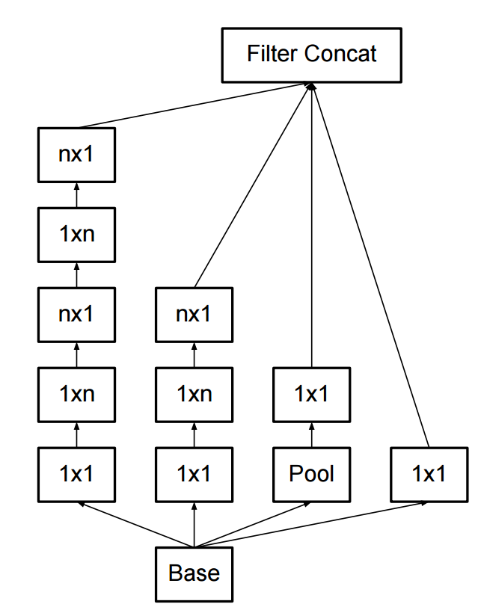
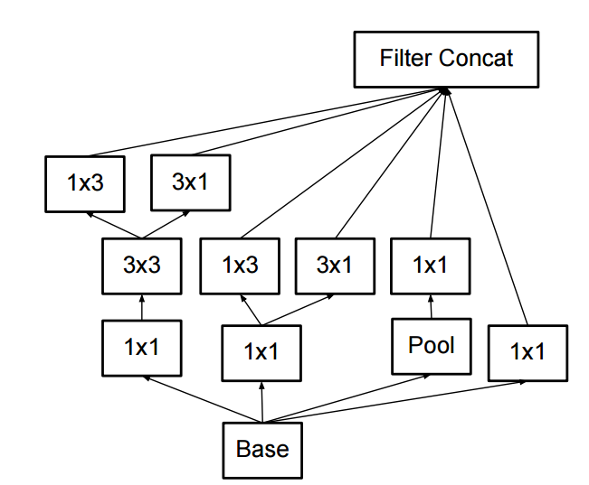
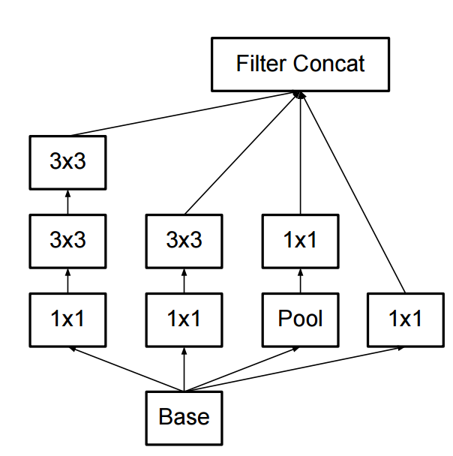
The power of small filters
Latest version of GoogLeNet incorporates all these ideas
Szegedy et al, “Rethinking the Inception Architecture for Computer Vision”

Slide 64
How to stack convolutions: Recap
Replace large convolutions (5 x 5, 7 x 7) with stacks of 3 x 3 convolutions
1 x 1 “bottleneck” convolutions are very efficient
Can factor N x N convolutions into 1 x N and N x 1
All of the above give fewer parameters, less compute, more nonlinearity

Slide 65
All About Convolutions Part II: How to compute them
Notes:
~ 45 minutes

Slide 66
Implementing Convolutions: im2col
There are highly optimized matrix multiplication routines for just about every platform
Can we turn convolution into matrix multiplication?

Slide 67
Implementing Convolutions: im2col
Feature map: H x W x C
Conv weights: D filters, each K x K x C

Slide 68
Implementing Convolutions: im2col
Feature map: H x W x C
Conv weights: D filters, each K x K x C
Reshape K x K x C receptive field to column with K²C elements

Slide 69
Implementing Convolutions: im2col
Feature map: H x W x C
Conv weights: D filters, each K x K x C
Repeat for all columns to get (K²C) x N matrix
(N receptive field locations)

Slide 70
Implementing Convolutions: im2col
Feature map: H x W x C
Conv weights: D filters, each K x K x C
Elements appearing in multiple receptive fields are duplicated; this uses a lot of memory
Repeat for all columns to get (K²C) x N matrix
(N receptive field locations)

Slide 71
Implementing Convolutions: im2col
Feature map: H x W x C
Conv weights: D filters, each K x K x C
Reshape each filter to K²C row,
making D x (K²C) matrix
(K²C) x N matrix

Slide 72
Implementing Convolutions: im2col
Feature map: H x W x C
Conv weights: D filters, each K x K x C
Matrix multiply
D x N result;
reshape to output tensor
(K²C) x N matrix
D x (K²C) matrix

Slide 73
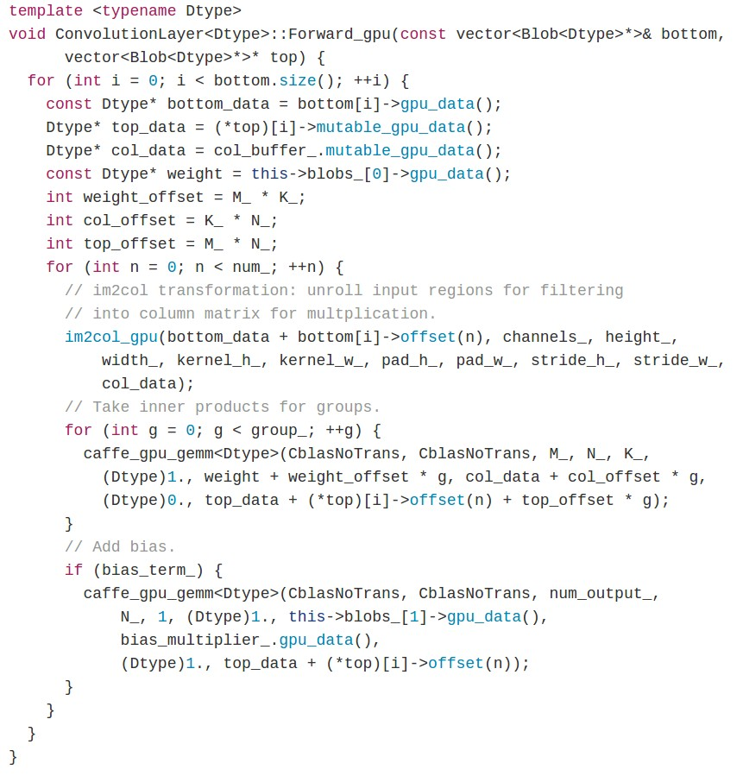
Case study:
CONV forward in Caffe library
im2col
matrix multiply: call to cuBLAS
bias offset

Slide 74
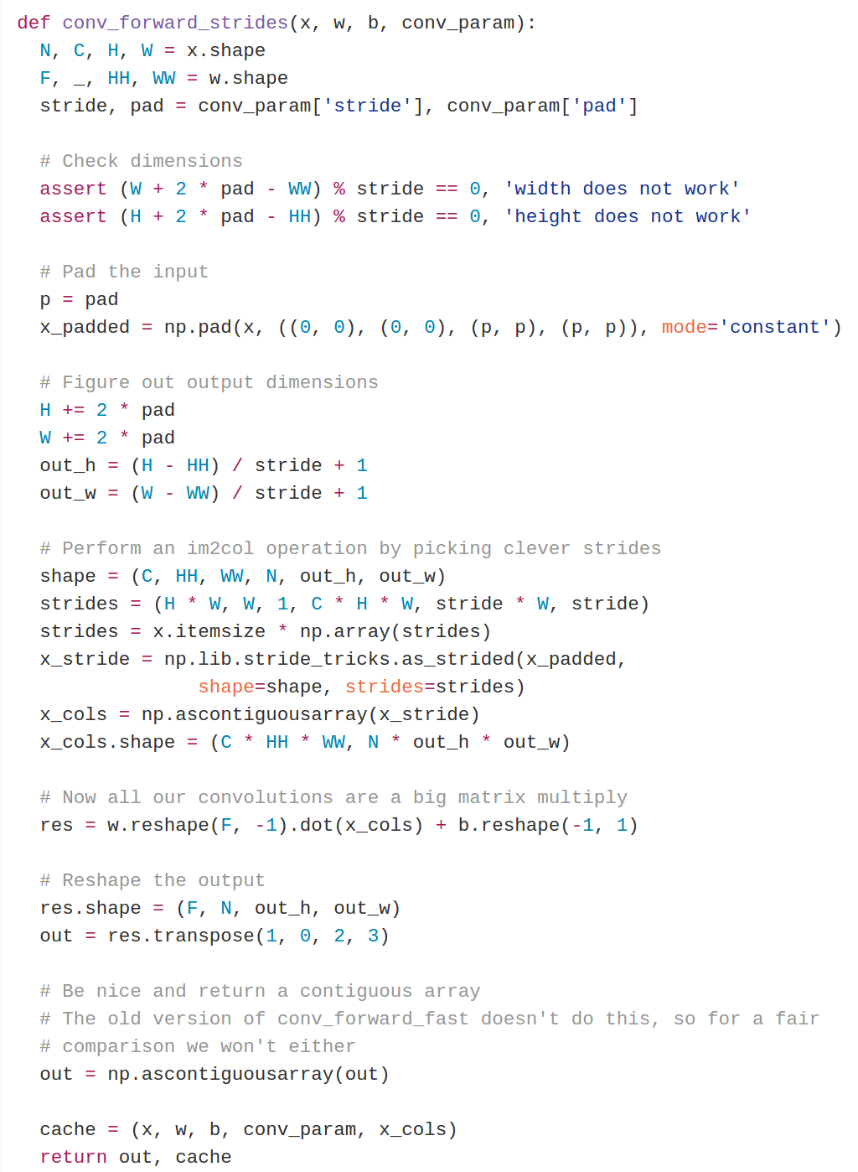
Case study:
fast_layers.py from HW
im2col
matrix multiply:
call np.dot (which calls BLAS)

Slide 75
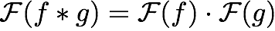
Implementing convolutions: FFT
Convolution Theorem: The convolution of f and g is equal to the elementwise product of their Fourier Transforms:
Using the Fast Fourier Transform, we can compute the Discrete Fourier transform of an N-dimensional vector in O(N log N) time (also extends to 2D images)

Slide 76
Implementing convolutions: FFT
Compute FFT of weights: F(W)
Compute FFT of image: F(X)
Compute elementwise product: F(W) ○ F(X)
Compute inverse FFT: Y = F⁻¹(F(W) ○ F(X))

Slide 77
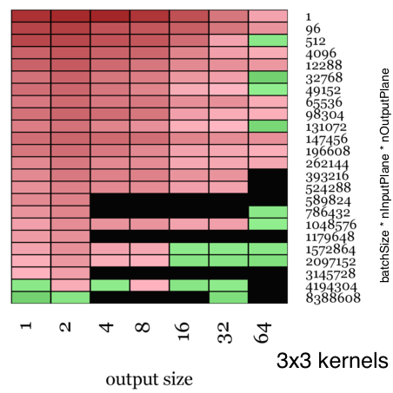
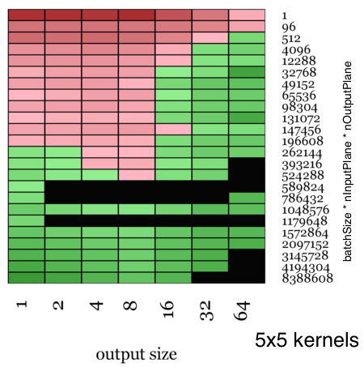
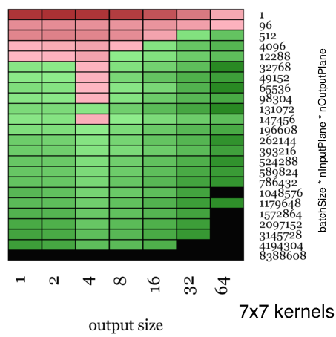
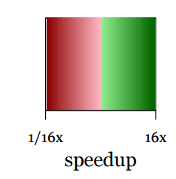
Implementing convolutions: FFT
FFT convolutions get a big speedup for larger filters
Not much speedup for 3x3 filters =(
Vasilache et al, Fast Convolutional Nets With fbfft: A GPU Performance Evaluation

Slide 78
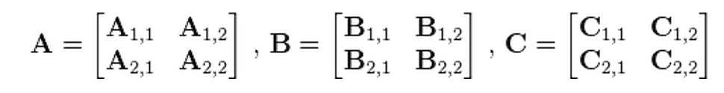
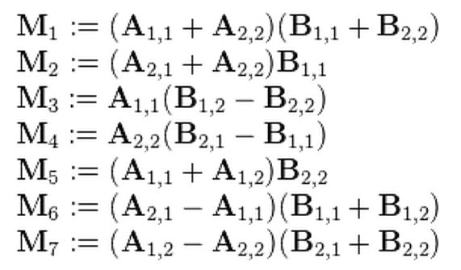
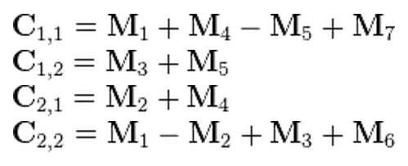
Implementing convolution: “Fast Algorithms”
Naive matrix multiplication: Computing product of two N x N matrices takes O(N³) operations
Strassen’s Algorithm: Use clever arithmetic to reduce complexity to O(N^{log2(7)}) ~ O(N^{2.81})
From Wikipedia

Slide 79
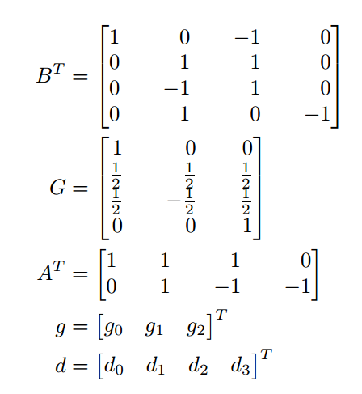
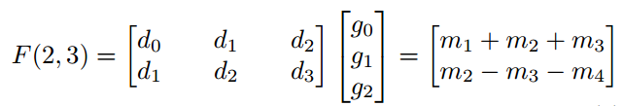
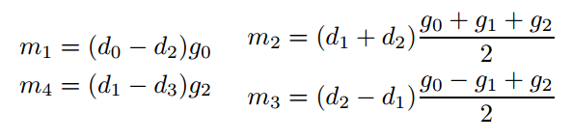
Implementing convolution: “Fast Algorithms”
Similar cleverness can be applied to convolutions
Lavin and Gray (2015) work out special cases for 3x3 convolutions:
Lavin and Gray, “Fast Algorithms for Convolutional Neural Networks”, 2015

Slide 80
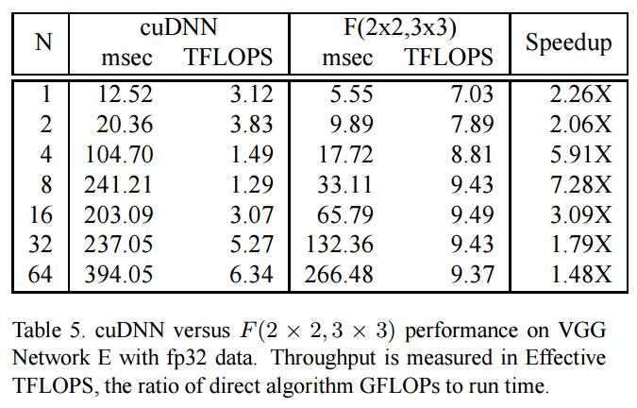
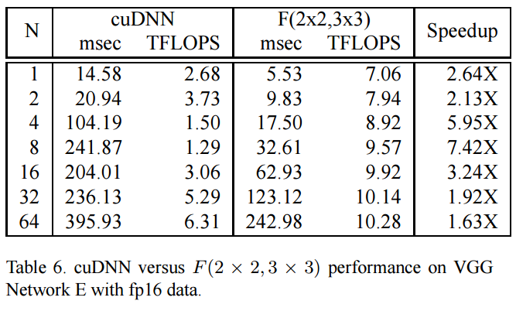
Implementing convolution: “Fast Algorithms”
Huge speedups on VGG for small batches:

Slide 81
Computing Convolutions: Recap
im2col: Easy to implement, but big memory overhead
FFT: Big speedups for small kernels
“Fast Algorithms” seem promising, not widely used yet
Notes:
~ 60 minutes

Slide 82
Implementation Details

Slide 83
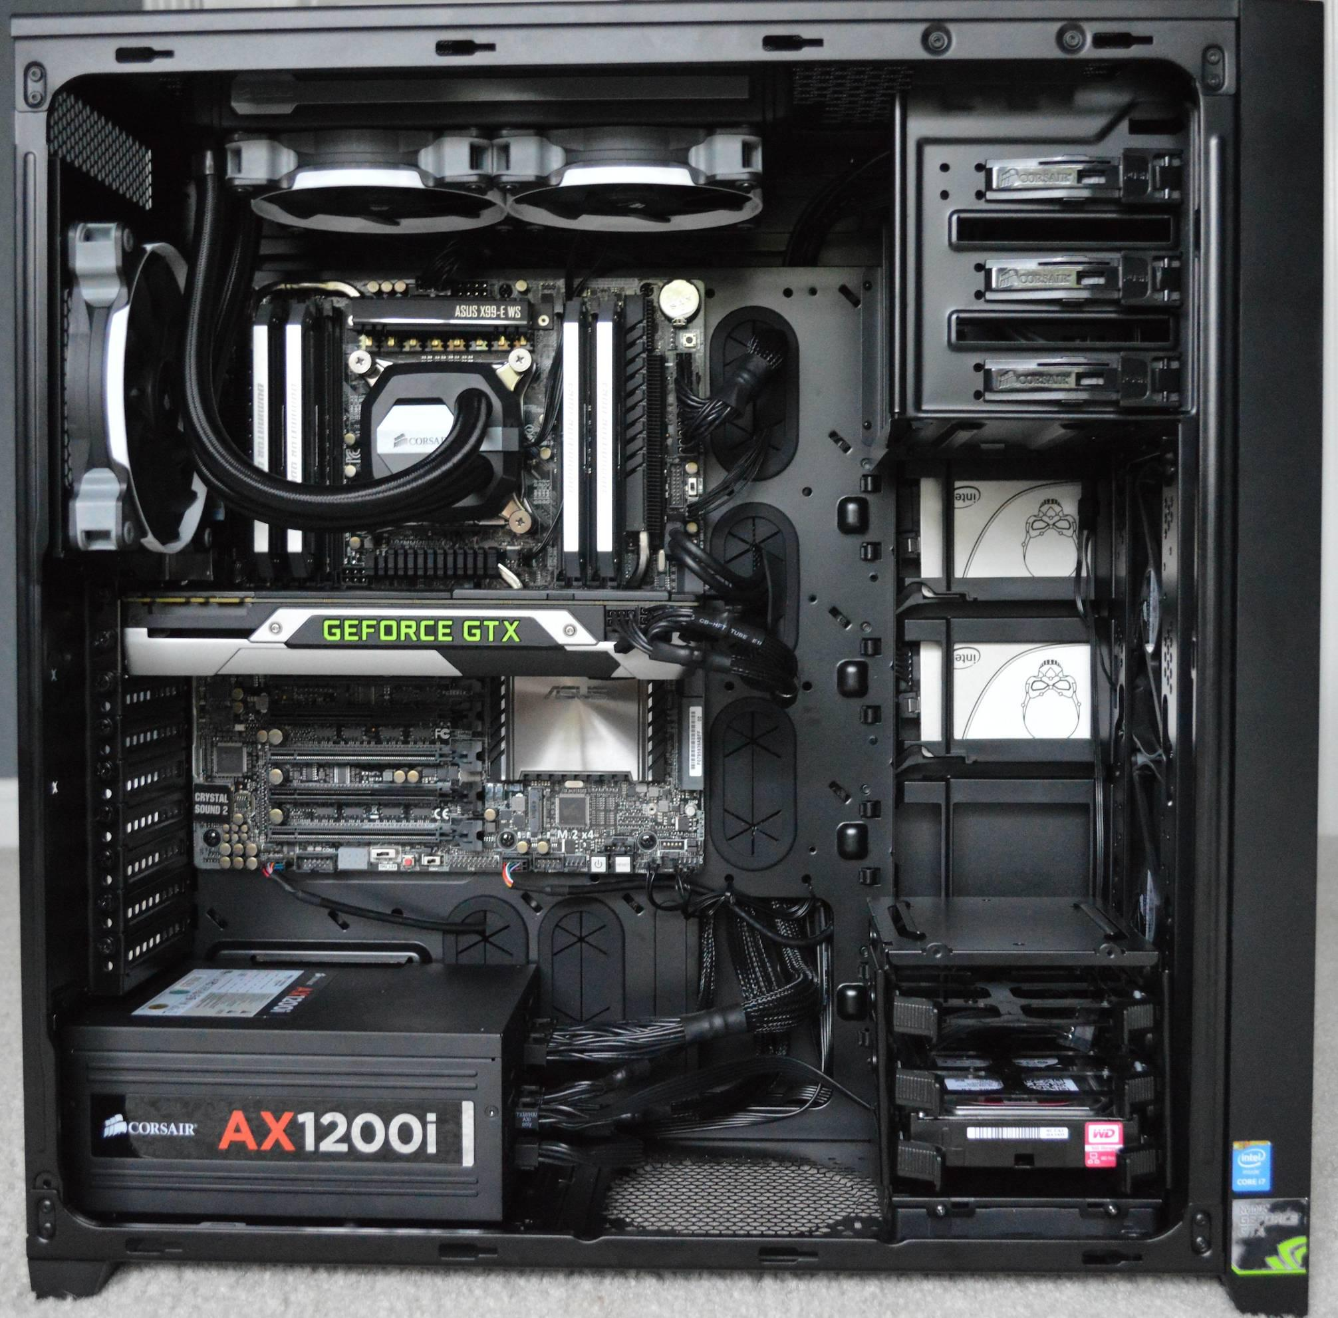

Slide 84
Spot the CPU!

Slide 85
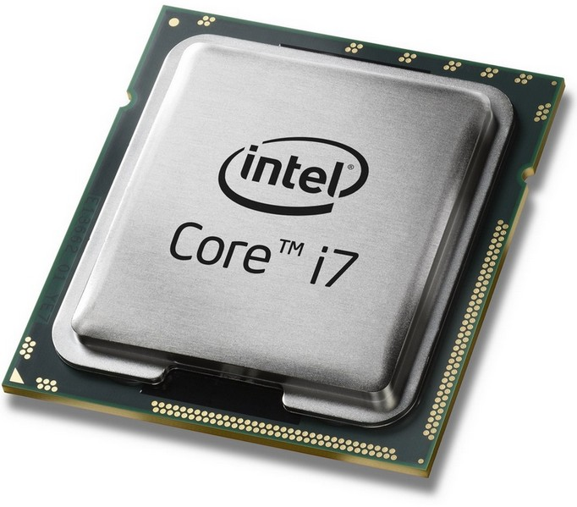
Spot the CPU!
“central processing unit”

Slide 86
Spot the GPU!
“graphics processing unit”

Slide 87
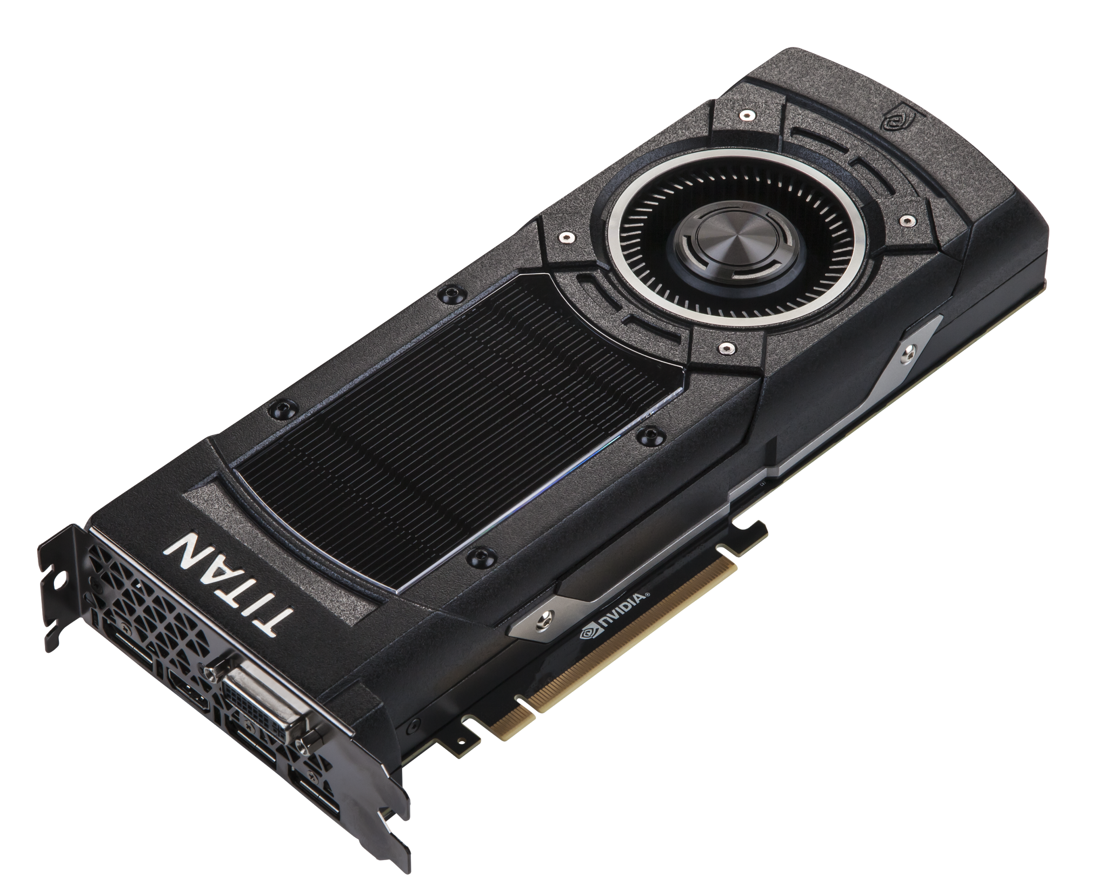
Spot the GPU!
“graphics processing unit”

Slide 88


VS

Slide 89
VS
NVIDIA is much more common for deep learning

Slide 90
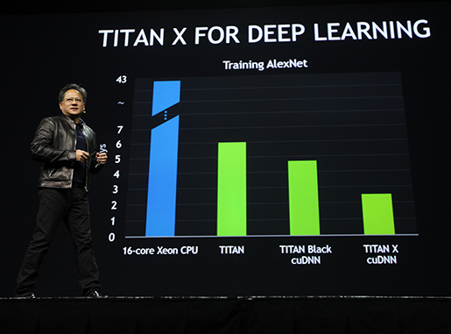
CEO of NVIDIA:
Jen-Hsun Huang
(Stanford EE Masters 1992)
GTC 2015:
Introduced new Titan X GPU by bragging about AlexNet benchmarks

Slide 91
CPU
Few, fast cores (1 - 16)
Good at sequential processing
GPU
Many, slower cores (thousands)
Originally for graphics
Good at parallel computation

Slide 92
GPUs can be programmed
CUDA (NVIDIA only)
Write C code that runs directly on the GPU
Higher-level APIs: cuBLAS, cuFFT, cuDNN, etc
OpenCL
Similar to CUDA, but runs on anything
Usually slower :(
Udacity: Intro to Parallel Programming https://www.udacity.com/course/cs344
For deep learning just use existing libraries

Slide 93
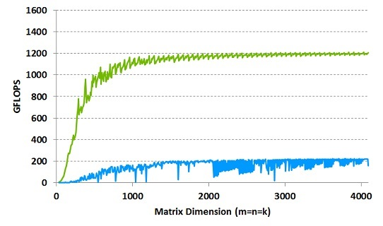
GPUs are really good at matrix multiplication:
GPU: NVIDA Tesla K40 with cuBLAS
CPU: Intel E5-2697 v2 12 core @ 2.7 Ghz with MKL

Slide 94
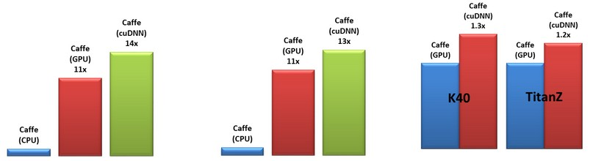
GPUs are really good at convolution (cuDNN):
All comparisons are against a 12-core Intel E5-2679v2 CPU @ 2.4GHz running Caffe with Intel MKL 11.1.3.

Slide 95
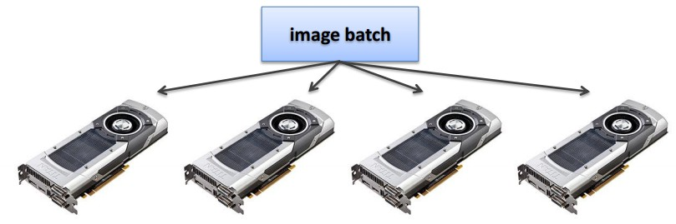
Even with GPUs, training can be slow
VGG: ~2-3 weeks training with 4 GPUs
ResNet 101: 2-3 weeks with 4 GPUs
NVIDIA Titan Blacks
~$1K each
ResNet reimplemented in Torch: http://torch.ch/blog/2016/02/04/resnets.html

Slide 96

Multi-GPU training: More complex
Alex Krizhevsky, “One weird trick for parallelizing convolutional neural networks”

Slide 97

Google: Distributed CPU training
Data parallelism
[Large Scale Distributed Deep Networks, Jeff Dean et al., 2013]

Slide 98

Google: Distributed CPU training
Data parallelism
Model parallelism
[Large Scale Distributed Deep Networks, Jeff Dean et al., 2013]

Slide 99

Google: Synchronous vs Async
Abadi et al, “TensorFlow: Large-Scale Machine Learning on Heterogeneous Distributed Systems”

Slide 100

Bottlenecks
to be aware of

Slide 101
GPU - CPU communication is a bottleneck.
=>
CPU data prefetch+augment thread running
while
GPU performs forward/backward pass

Slide 102


Moving parts lol
CPU - disk bottleneck
Hard disk is slow to read from
=> Pre-processed images
stored contiguously in files, read as
raw byte stream from SSD disk

Slide 103
GPU memory bottleneck
Titan X: 12 GB <- currently the max
GTX 980 Ti: 6 GB
e.g.
AlexNet: ~3GB needed with batch size 256

Slide 104
Floating Point Precision

Slide 105
Floating point precision
64 bit “double” precision is default in a lot of programming
32 bit “single” precision is typically used for CNNs for performance

Slide 106

Floating point precision
64 bit “double” precision is default in a lot of programming
32 bit “single” precision is typically used for CNNs for performance
Including cs231n homework!

Slide 107



Floating point precision
Benchmarks on Titan X, from https://github.com/soumith/convnet-benchmarks
Prediction: 16 bit “half” precision will be the new standard
Already supported in cuDNN
Nervana fp16 kernels are the fastest right now
Hardware support in next-gen NVIDIA cards (Pascal)
Not yet supported in torch =(

Slide 108

Floating point precision
How low can we go?
Gupta et al, 2015: Train with 16-bit fixed point with stochastic rounding
CNNs on MNIST
Gupta et al, “Deep Learning with Limited Numerical Precision”, ICML 2015

Slide 109
Floating point precision
How low can we go?
Courbariaux et al, 2015: Train with 10-bit activations, 12-bit parameter updates
Courbariaux et al, “Training Deep Neural Networks with Low Precision Multiplications”, ICLR 2015

Slide 110
Floating point precision
How low can we go?
Courbariaux and Bengio, February 9 2016:
Train with 1-bit activations and weights!
All activations and weights are +1 or -1
Fast multiplication with bitwise XNOR
(Gradients use higher precision)
Courbariaux et al, “BinaryNet: Training Deep Neural Networks with Weights and Activations Constrained to +1 or -1”, arXiv 2016

Slide 111
Implementation details: Recap
GPUs much faster than CPUs
Distributed training is sometimes used
Not needed for small problems
Be aware of bottlenecks: CPU / GPU, CPU / disk
Low precison makes things faster and still works
32 bit is standard now, 16 bit soon
In the future: binary nets?

Slide 112
Recap
Data augmentation: artificially expand your data
Transfer learning: CNNs without huge data
All about convolutions
Implementation details

